Slide 1
Taking Care of Vizness
Graphing and Reporting with R
Shannon Haymond, PhD
Northwestern BDSD 2020

Slide 2

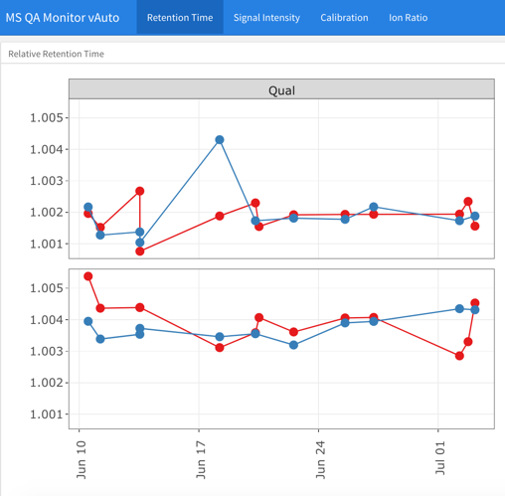
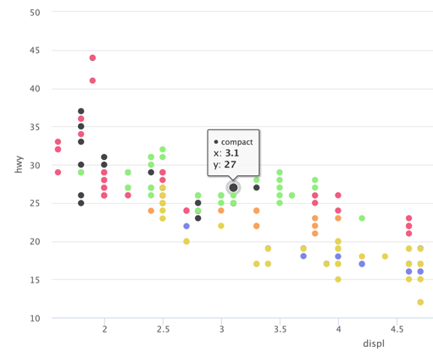
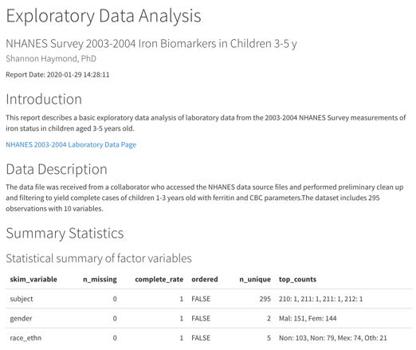

Slide 3
Learning Objectives
Best practices for reproducible data analysis and visualization workflows and how these can be applied in R and RStudio
Produce highly effective, publication-quality graphics
Generate shareable reports from R Notebooks

Slide 4
Please open RStudio
Materials for today’s session:
https://github.com/SHaymond/NU_BDSD2020

Slide 5
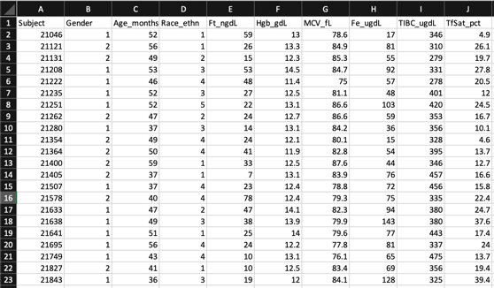
A familiar scenario?
?
Notes:
What do people use for analyzing, visualizing and communicating data?

Slide 6
Is your analysis reproducible?
Are the steps transparent?
Can you automate the process?
Can you scale the process?
Is the process organized?

Slide 7


There’s a better way!
R Notebooks
R Projects
Notes:
Last but not least, your computing results will be more likely to be reproducible if you use R Markdown (or other knitr-based source documents), compared to the manual cut-and-paste approach. This is because the results are dynamically generated from computer source code. If anything goes wrong or needs to be updated, you can simply fix or update the source code, compile the document again, and the results will automatically updated. You can enjoy reproducibility and convenience at the same time.

Slide 8
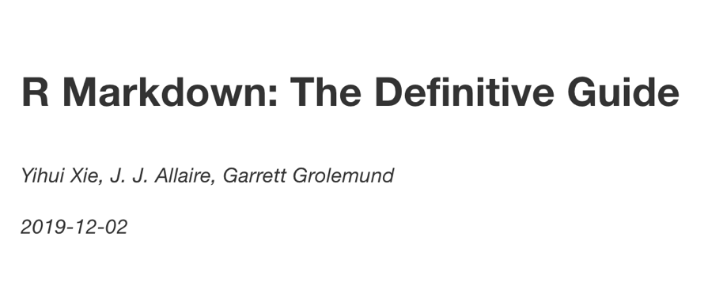
https://bookdown.org/yihui/rmarkdown/
Great resource!

Slide 9
What is R Markdown?
R Markdown is an R package and a set of tools that are deeply embedded in RStudio
Specific authoring format that enables documents that combine text, R code, and the output from that code (tables, graphics, etc) in a way that is best for human understanding – facilitates literate programming
Any R Markdown document can be used as a Notebook
Notes:
R Notebooks are an implementation of Literate Programming that allows for direct interaction with R while producing a reproducible document with publication-quality output.
Any R Markdown document can be used as a notebook, and all R Notebooks can be rendered to other R Markdown document types. A notebook can therefore be thought of as a special execution mode for R Markdown documents. The immediacy of notebook mode makes it a good choice while authoring the R Markdown document and iterating on code. When you are ready to publish the document, you can share the notebook directly, or render it to a publication format with the Knit button.

Slide 10
What is an R Notebook?
Notebooks are R Markdown documents with chunks that can be executed independently and interactively, with output visible immediately beneath the input and Viewer tab – great for iterating code.
All R Notebooks can be rendered to other R Markdown document types
Notes:
R Notebooks are an implementation of Literate Programming that allows for direct interaction with R while producing a reproducible document with publication-quality output.
Any R Markdown document can be used as a notebook, and all R Notebooks can be rendered to other R Markdown document types. A notebook can therefore be thought of as a special execution mode for R Markdown documents. The immediacy of notebook mode makes it a good choice while authoring the R Markdown document and iterating on code. When you are ready to publish the document, you can share the notebook directly, or render it to a publication format with the Knit button.

Slide 11
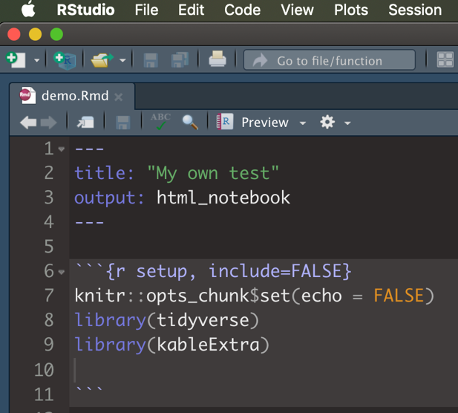
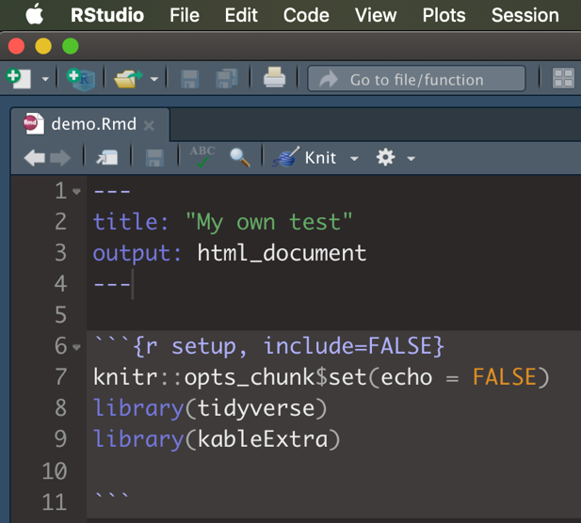
R Notebook
R Markdown

Slide 12
R Projects
A built-in feature in RStudio to help you keep all the files associated with a project together — input data, R scripts, analytical results, figures.
A lifesaver for your future self and collaborators!

Slide 13

What have we learned so far?
Basic understanding of
R vs RStudio – have seen RStudio IDE and some R code
R Markdown/Notebooks
R projects
Let’s put it all together and go through a very simple workflow for taking structured data, performing basic EDA, and generating a shareable report

Slide 14
We’ll use 3 steps
Organize
Analyze
Render
R Project
R Notebook
R Notebook

Slide 15
1.
Organize
Let’s start by creating an R Project for this analysis

Slide 16
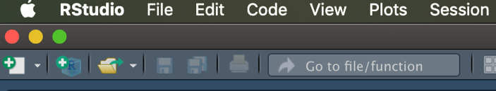
1. Use New Project button on toolbar 2. Use New Project command from File tab
Create a Project

Slide 17
What happens in RStudio?
Creates a project file (.Rproj extension) within project directory
Creates hidden directory for project-specific temporary files
A new R session is started
The current working directory is set to the project directory
Loads in whatever was there prior – if options indicate
Loads the project and displays name in Projects toolbar.
Notes:
Creates a project file (with an .Rproj extension) within the project directory.
Creates a hidden directory (named .Rproj.user) where project-specific temporary files (e.g. auto-saved source documents, window-state, etc.) are stored.
Loads the project into RStudio and display its name in the Projects toolbar (which is located on the far right side of the main toolbar)

Slide 18
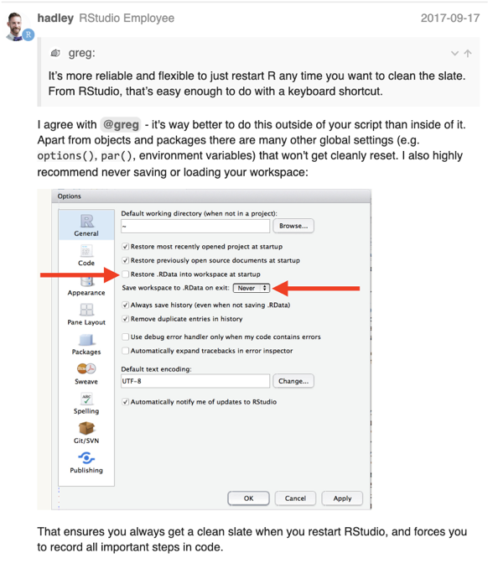
Start each R session with a fresh environment!

Slide 19
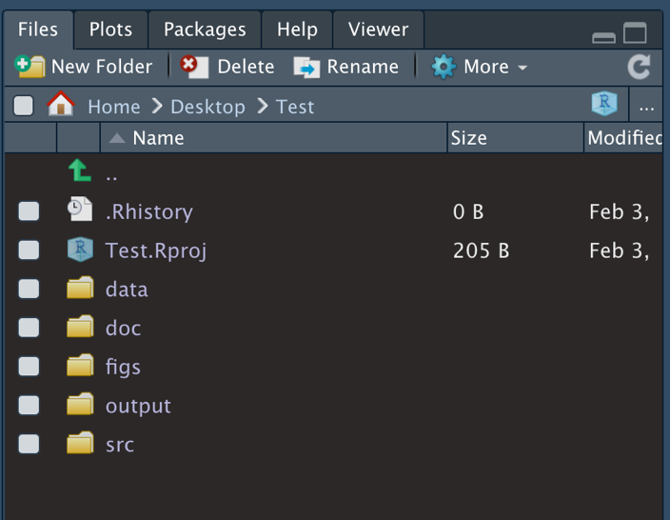
Within RStudio
Set up file system
Now all files for this project are together and organized
Notes:
Data – keep raw data input files here
Src – keep your R scripts here
Outputs – save tables, or processed data here
Figs – save plots and visuals here
Docs – references, other files

Slide 20
2.
Analyze/Summarize
Next, we’ll use R Notebook to analyze/summarize data

Slide 21
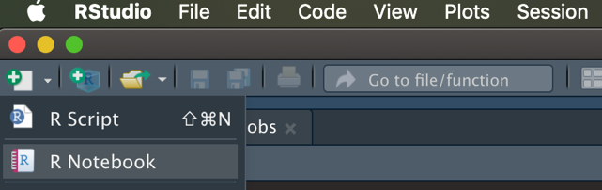
1. Use New File >> R Notebook button on toolbar 2. Use New File >> R Notebook command from File tab
Create new R Notebook

Slide 22
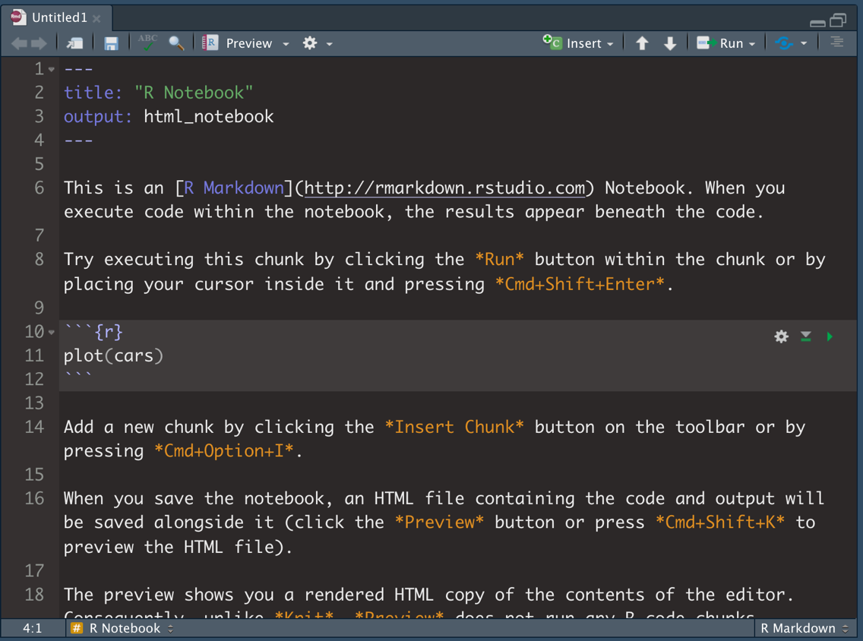
Text with formatting and hyperlinks
YAML
R code chunk
Notes:
Note R code chunk syntax and shortcut

Slide 23

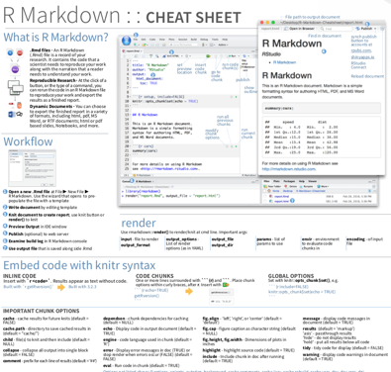
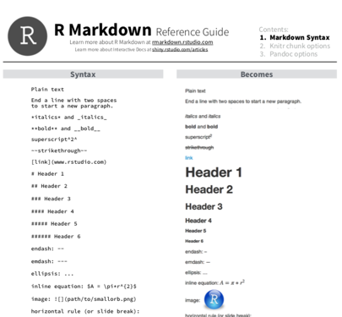
More great resources!

Slide 24
Customize the YAML options.
Change the YAML title to your own title
Add a YAML option for author

Slide 25
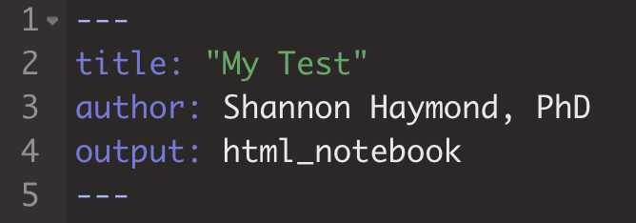

Slide 26
Create a new code chunk to define the setup options.
Label the chunk, tell R what to do with the chunk when rendering
Set options for the document
Load necessary packages
Execute your code.
Setup chunk goes at the top, so it runs first!

Slide 27
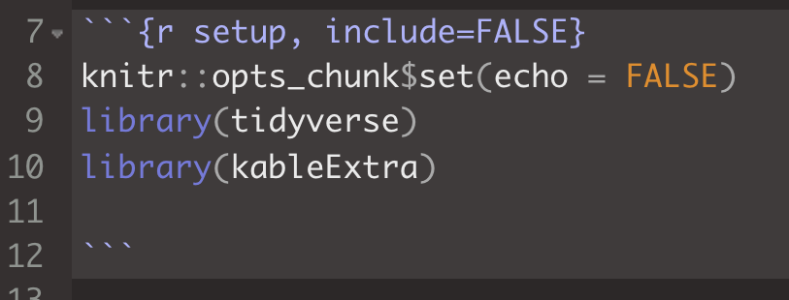
Prevents code and results from appearing in the finished file (default = TRUE)
Display code in output document (default = TRUE)

Slide 28
Add your own text and create a new code chunk to read in your data.
Write some text that describes your report.
Create a new code chunk and label it.
Tell R what to do with the chunk when rendering.
Write the code to read in your data.
Execute your code.

Slide 29
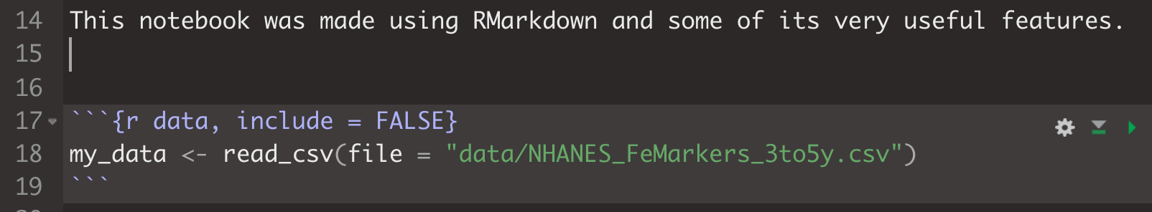
Note syntax for R chunk
New chunk:
*Insert Chunk* button on the toolbar or by pressing Cmd+Option+I or Ctrl+Alt+I
Execute code:
Press *play* button to run entire chunk or select and press Cmd+Enter or Ctrl+Enter

Slide 30
Make a basic stats summary table with an italicized title.
Use syntax for text to italicize the table’s title.
Create a new code chunk and label it.
Write the code to create your summary table and format it.
Execute your code.

Slide 31
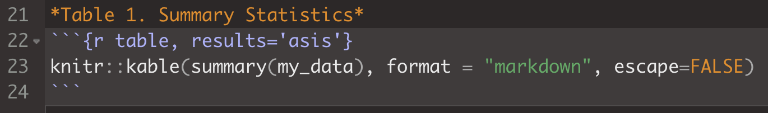
*words* = words
Function call for styling HTML table
Function call to make the summary stats table

Slide 32
Use syntax to write inline code that summarizes results from the table.
Use inline code syntax to calculate the number of rows in the data table and include this within a sentence.

Slide 33
Inline code syntax:
`r code here`
Use backtick, not single quote!

Slide 34
Create a scatterplot of TfSat_pct and Fe_ugdL with an italicized title.
Use syntax for text to italicize the plot’s title.
Create a new code chunk and label it.
Write the code to create your plot.
Execute your code.

Slide 35
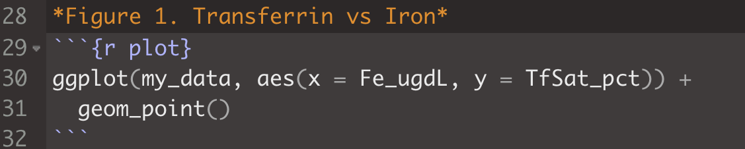
*words* = words
ggplot(data = <DATA>, aes(x = <X_DATA>, y = <Y_DATA>)) +
<GEOM_FUNCTION>

Slide 36
Preview your document in the Viewer pane
Preview the document
Review it in the Viewer pane

Slide 37
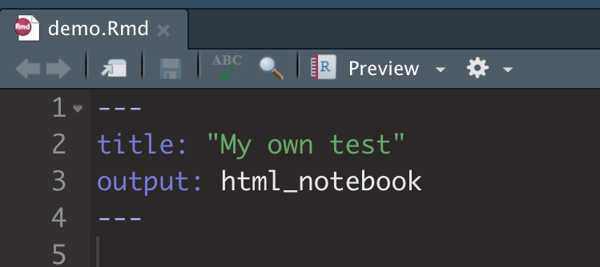
This output type is for R Notebooks

Slide 38
3.
Render
Finally, we’ll format our report and export it

Slide 39
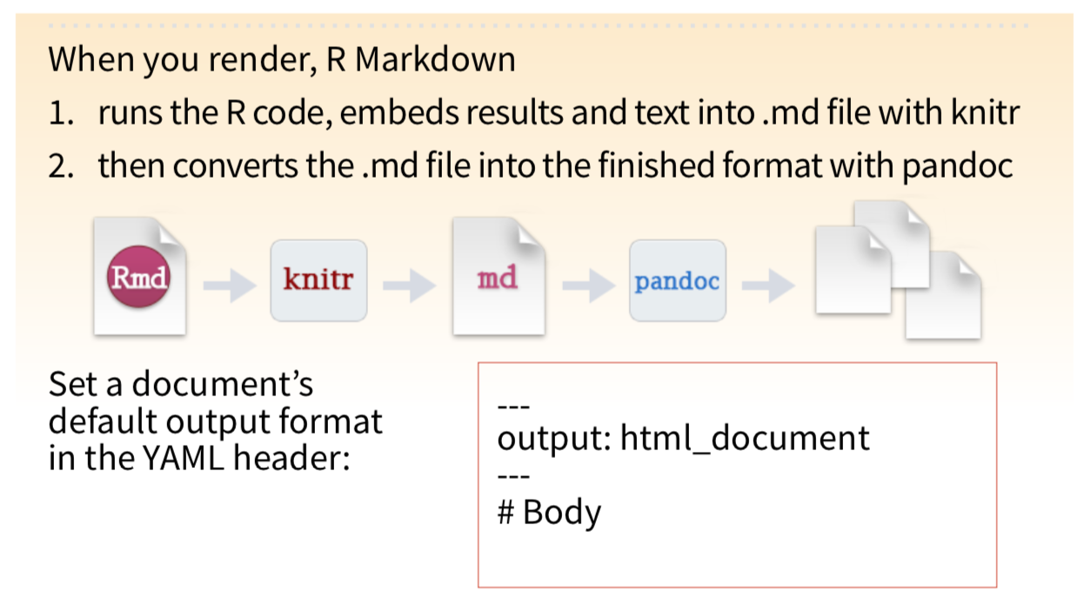

Slide 40
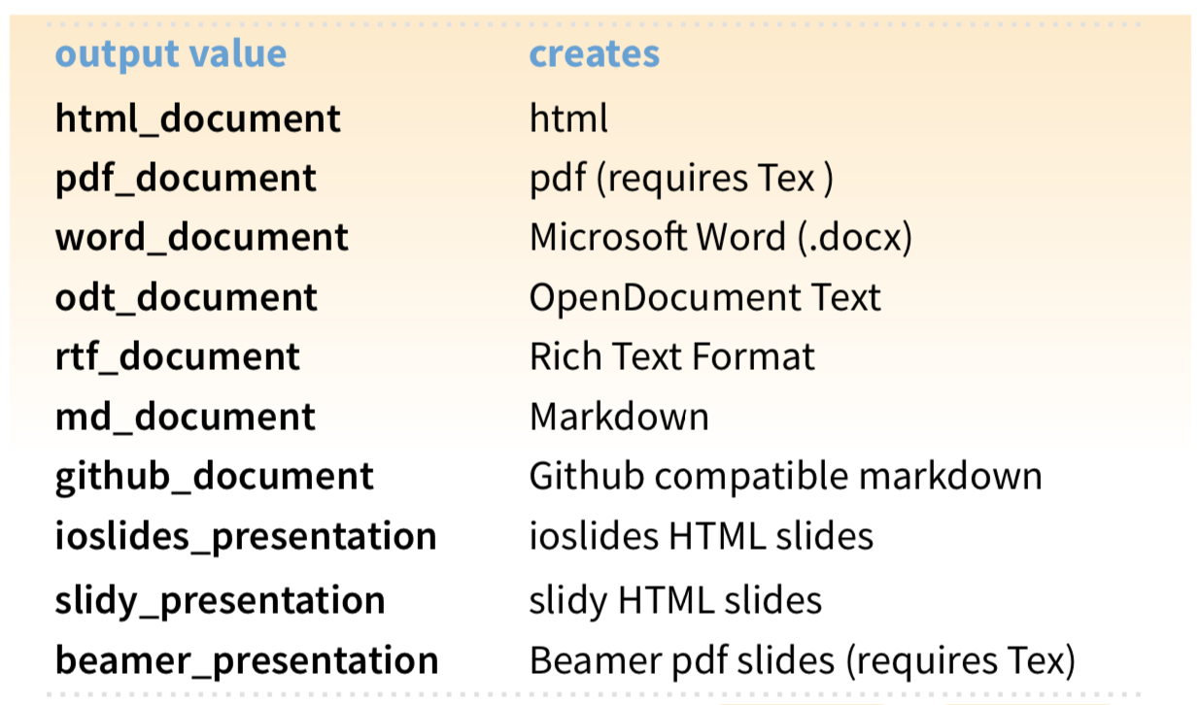

Slide 41
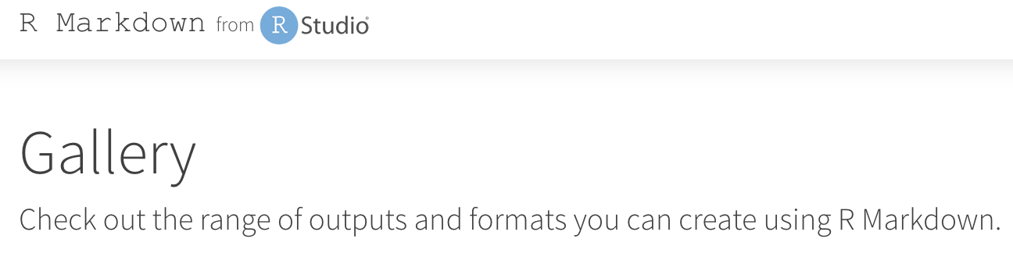
https://rmarkdown.rstudio.com/gallery.html

Slide 42
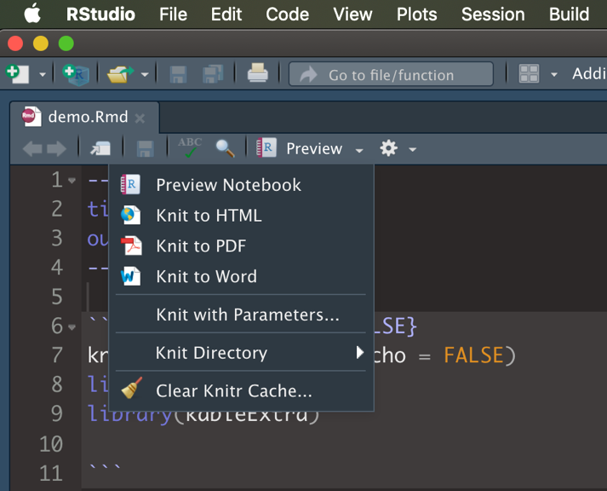
Export our Report

Slide 43
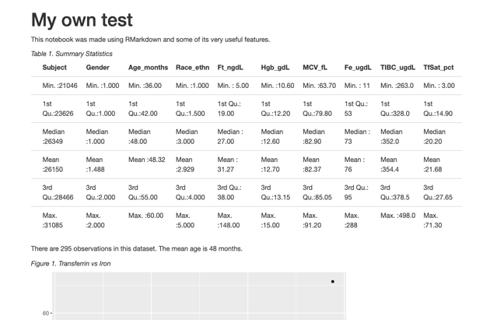
HTML Reports
Place your screenshot here
Customization
Distribution
Interactivity

Slide 44
We did it!
Organize
Analyze
Render
R Project
R Notebook
R Notebook

Slide 45
BONUS!
Add customization and interactivity

Slide 46
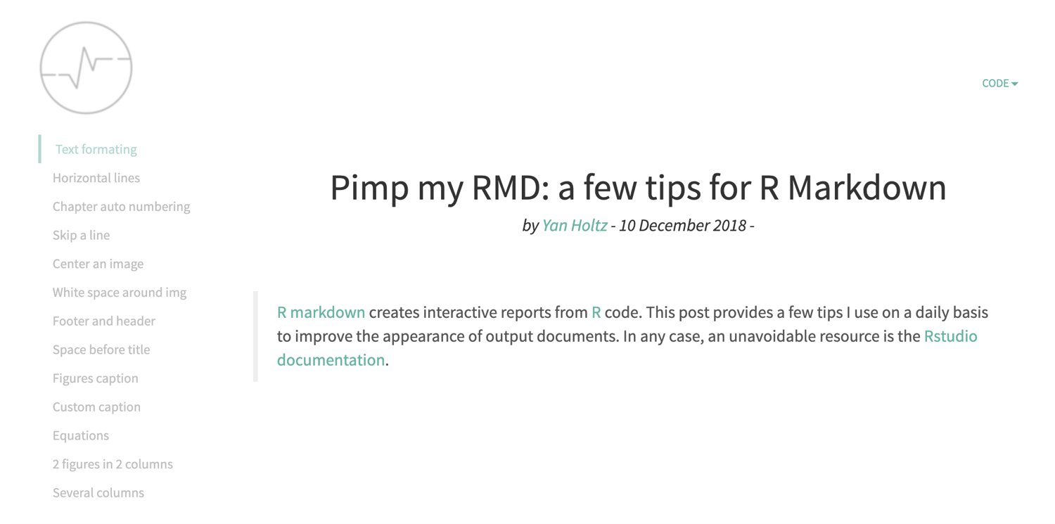
https://holtzy.github.io/Pimp-my-rmd/

Slide 47

https://www.datadreaming.org/post/r-markdown-theme-gallery/

Slide 48
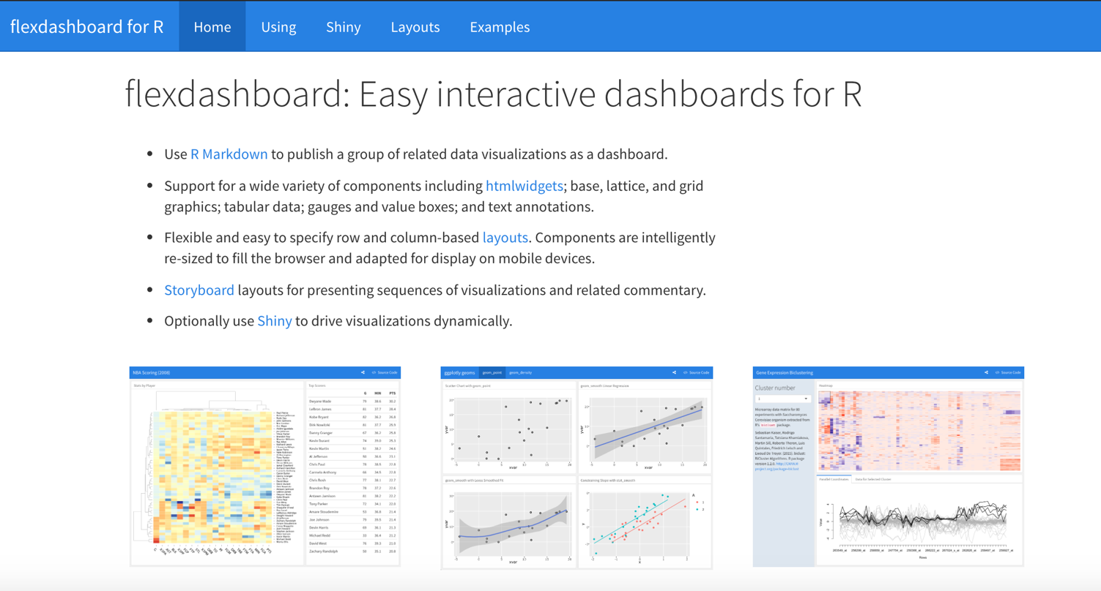
https://rmarkdown.rstudio.com/flexdashboard/

Slide 49
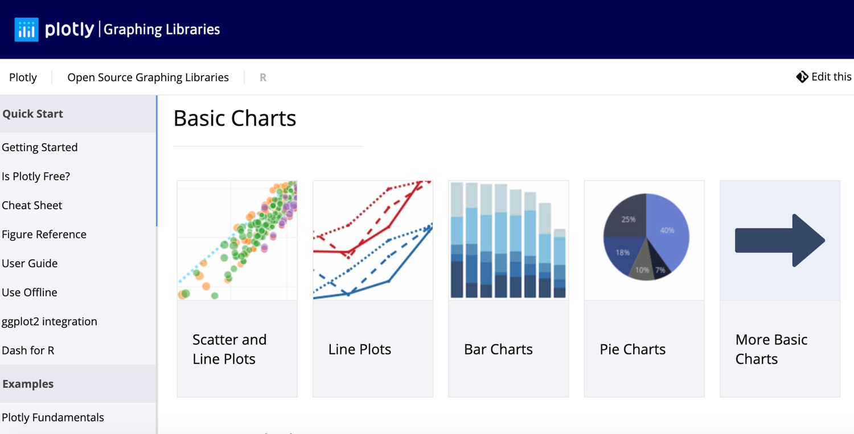
https://plot.ly/r/

Slide 50
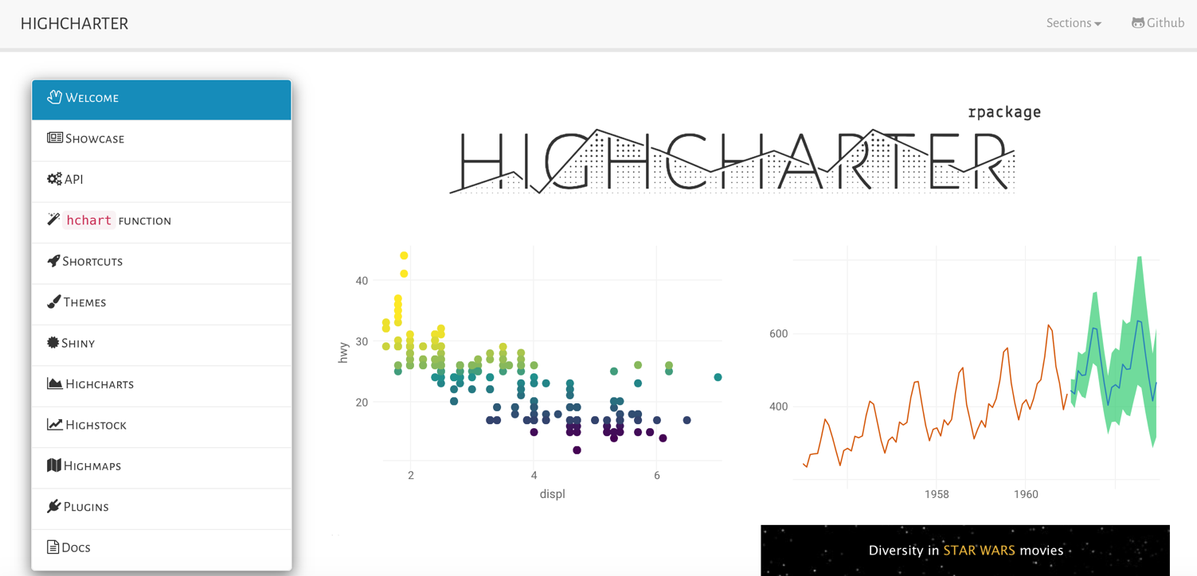
http://jkunst.com/highcharter/

Slide 51
flexdashboard w/
ggplotly
highcharter
cosmos theme

Slide 52
Thanks!
Any questions?
You can find me at:
@SHaymondSays
s-haymond@northwestern.edu
Special thanks to the people who made and released this presentation template for free at SlidesCarnival

